Slide 1










Solving
Mysteries
with Privacy
UT Austin Student Group
Notes:
Brando

Slide 2







Who are we?
Ethan
Timmy
Kimble
Nikita
Brinda
Kedar
Brando
Notes:
Everyone

Slide 3
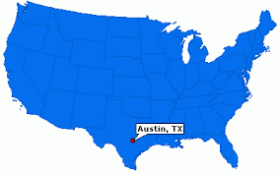
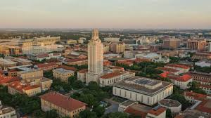
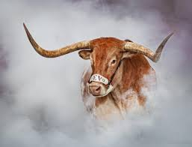
Where are we from?
Notes:
Brando

Slide 4
Your Turn to Share!
Notes:
Brando

Slide 5

TABLE OF CONTENTS
01.
02.
03.
04.
What is Privacy?
Mystery
Game!
Differential Privacy?
Protecting your secrets!
Notes:
Brando

Slide 6


MANDATORY PAGE
What is Privacy?
01.
Notes:
Ethan

Slide 7
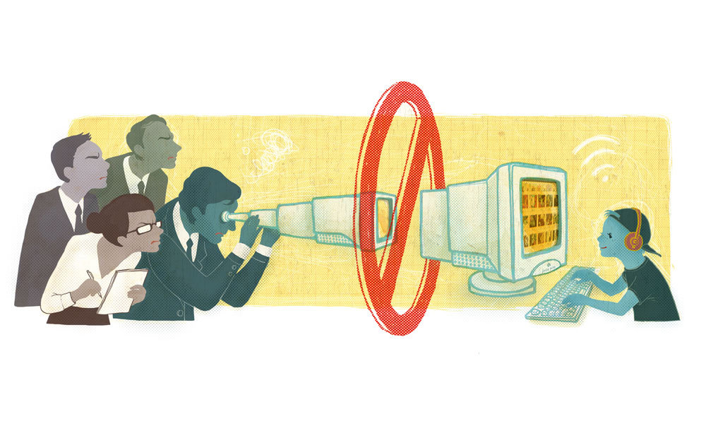
Keeping your personal information safe!
Personal Information means things like:
Your name, birthday, or address
Your favorite games or activities
Your passwords are secrets
It is any information that can identify or reveal something about you.
You wouldn’t want strangers to know all your secrets, right?
Notes:
Ethan
Image Source: https://www.nytimes.com/2012/11/06/technology/silicon-valley-objects-to-online-privacy-rule-proposals-for-children.html

Slide 8
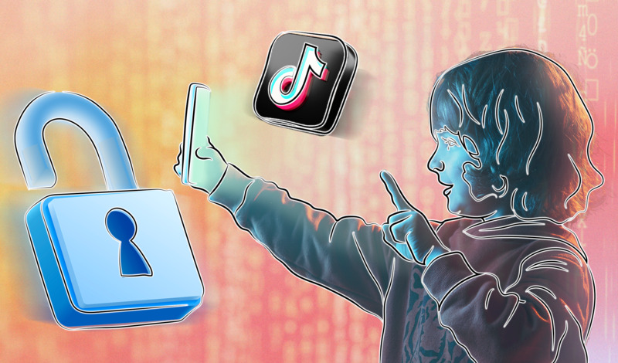
Why is Privacy so Important?
1. Privacy helps you stay safe online and in real life!
2. It gives you control over who can see your information.
3. It protects you from bad people who might misuse your information.
What would happen if everyone knew your secrets?
Notes:
Ethan
Image Source: https://web-mind.io/cyber-security/tiktok-should-ve-known-better-16m-fine-for-misusing-kids-data/

Slide 9
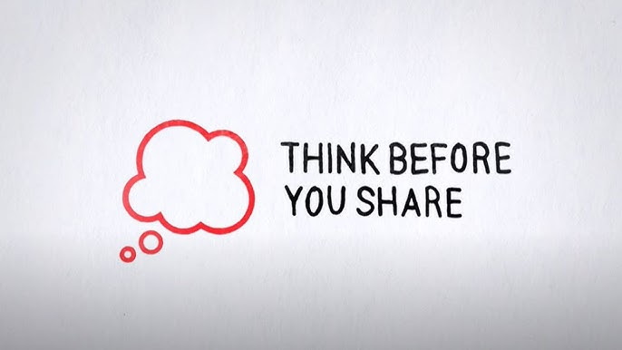
What Information Should You Keep Private?
1. Your Passwords!
You don’t want a stranger stealing your Minecraft or Roblox Account right?
2. Your address and phone number
3. Personal details (where you go to school)
4. Anything you wouldn’t want everyone else to know!
Notes:
Image Source: https://www.youtube.com/watch?v=BcdZm3WAF4A

Slide 10
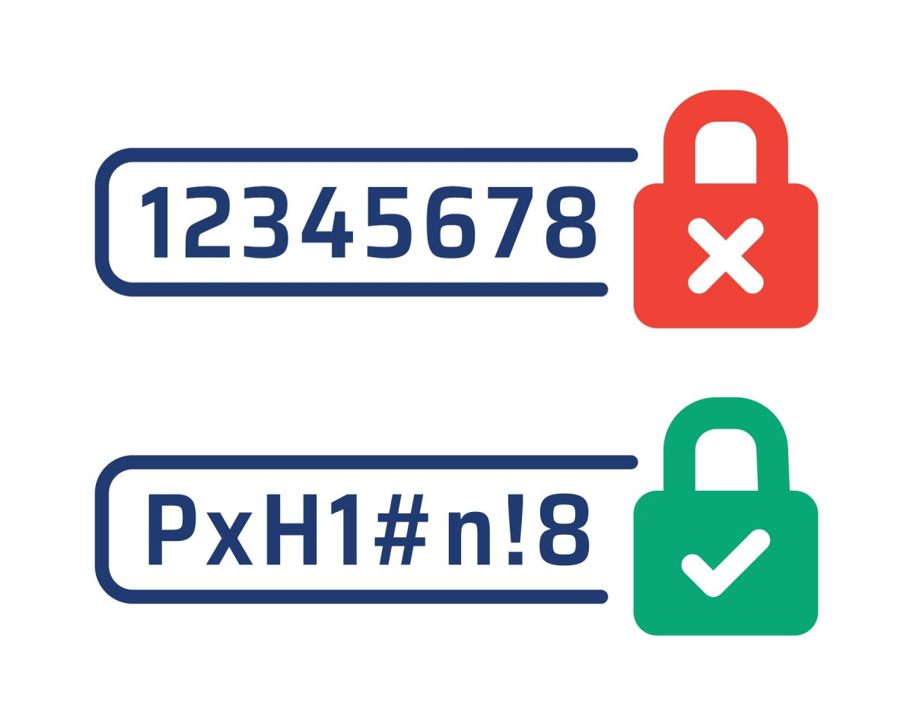
How can you protect your privacy?
1. Use strong passwords (like a secret code!)
2. Be careful about what you share online.
3. Only talk to people you know and trust.
4. Ask an adult if you’re unsure.
5. NEVER LEAVE A PHONE/IPAD/COMPUTER UNLOCKED
Notes:
Image Source: https://www.ssbwyo.bank/tips-for-creating-strong-passwords/

Slide 11

A Fun Rule to Remember!
Protect your privacy like your Minecraft base!
Notes:
Ethan
Would you leave your diamond stash out in the open? No way!
Build strong walls (passwords) to keep out creepers (hackers).
Only invite trusted players (friends and family) to your world.
"Treat your personal info like your best Minecraft loot – keep it safe and secure!"

Slide 12
Who is ready to play a game?

Slide 13

Mystery Game!
02.
Notes:
Kimble

Slide 14




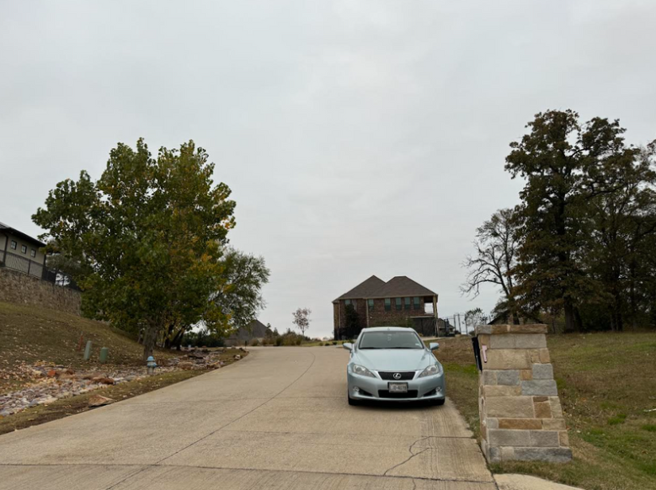
iSpy Something Light Blue
Notes:
Kimble
car - 2

Slide 15

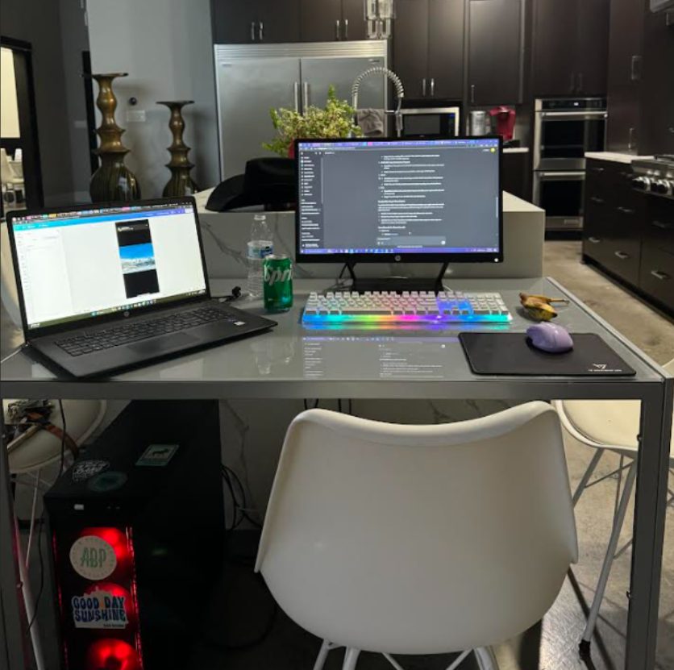

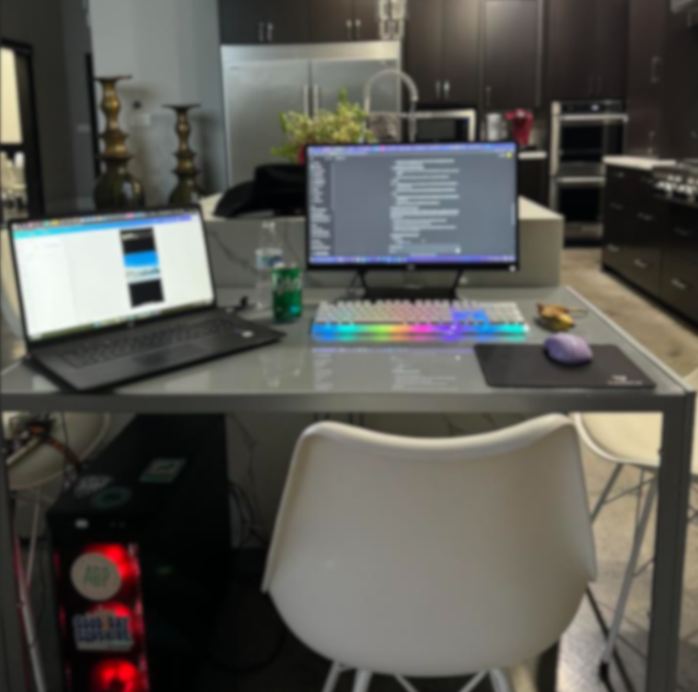

iSpy Something Yellow
Notes:
Kimble
banana - 3/4

Slide 16





iSpy Something Black
Notes:
Kimble
cowboy hat - 3/4

Slide 17


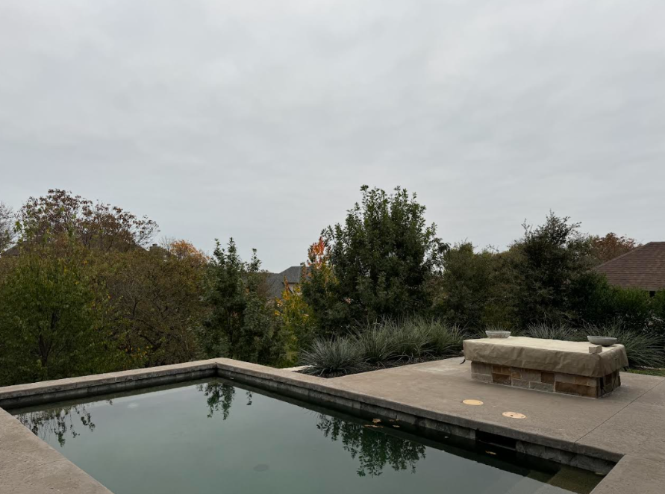


iSpy Something Green, Yellow and Orange
Notes:
Kimble
trees/leaves - 2/3

Slide 18

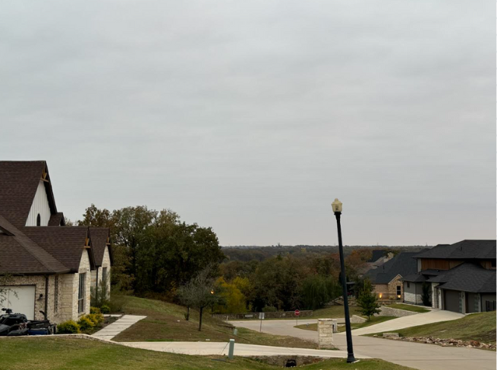



iSpy Something Red
Notes:
Kimble
stop sign -3/4

Slide 19





iSpy Something Multicolored
Notes:
Kimble
christmas lights - 3/4

Slide 20

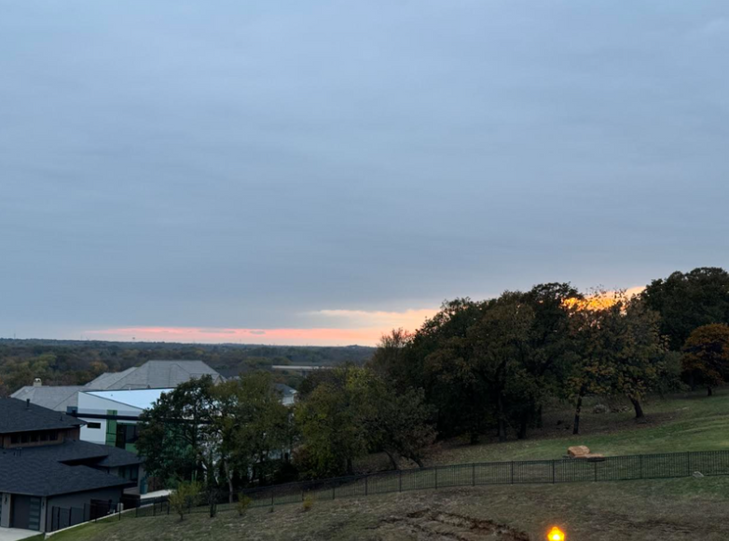



iSpy Something Orange
Notes:
Kimble
sunset - 2/3

Slide 21
MANDATORY PAGE
What is Differential Privacy?
03.
Notes:
Kedar/Nikita

Slide 22
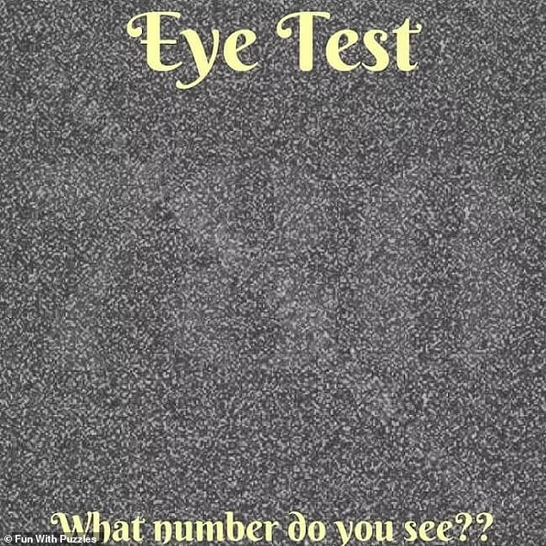
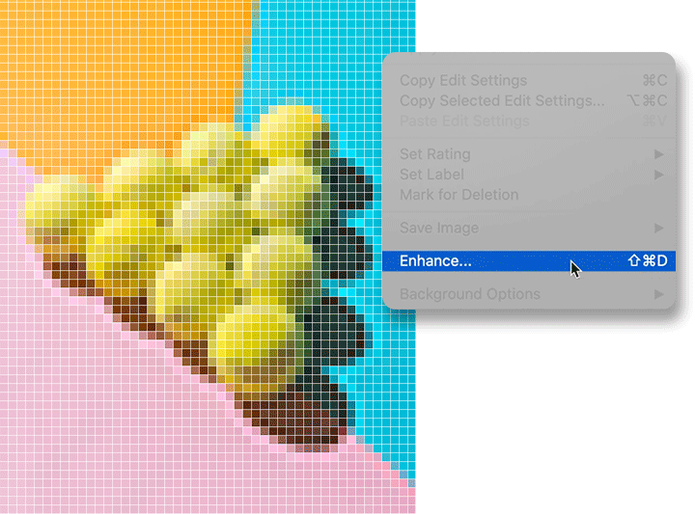
Differential Privacy (DP) Explained
Imagine you're a spy hiding in a photo. To do so, you distort it. This makes it hard for anyone to figure out exactly who you are! We call this Differential Privacy!
How It Works:
Add noise to your data (like adding radio static to a clear broadcast); how much noise to add is what we can control!
This noise helps to hide exact details
Humans cannot tell; but a computer will be able to tell!
Notes:
Kedar
Image Source: https://www.dailymail.co.uk/sciencetech/article-12198013/Can-TV-static-number-hidden-it.html
GIF source : https://www.adobe.com/creativecloud/photography/discover/increase-resolution.html

Slide 23
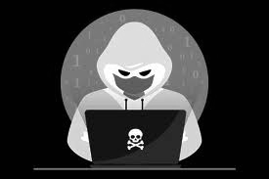
Differential Privacy in the Game?
1. Blurring Images → Noise
2. The more blurry → More difficult to know the truth
3. This “noise” is how companies try to protect your data
4. When the data is “blurry” it makes it difficult for criminals to see your true information
Notes:
Kedar

Slide 24
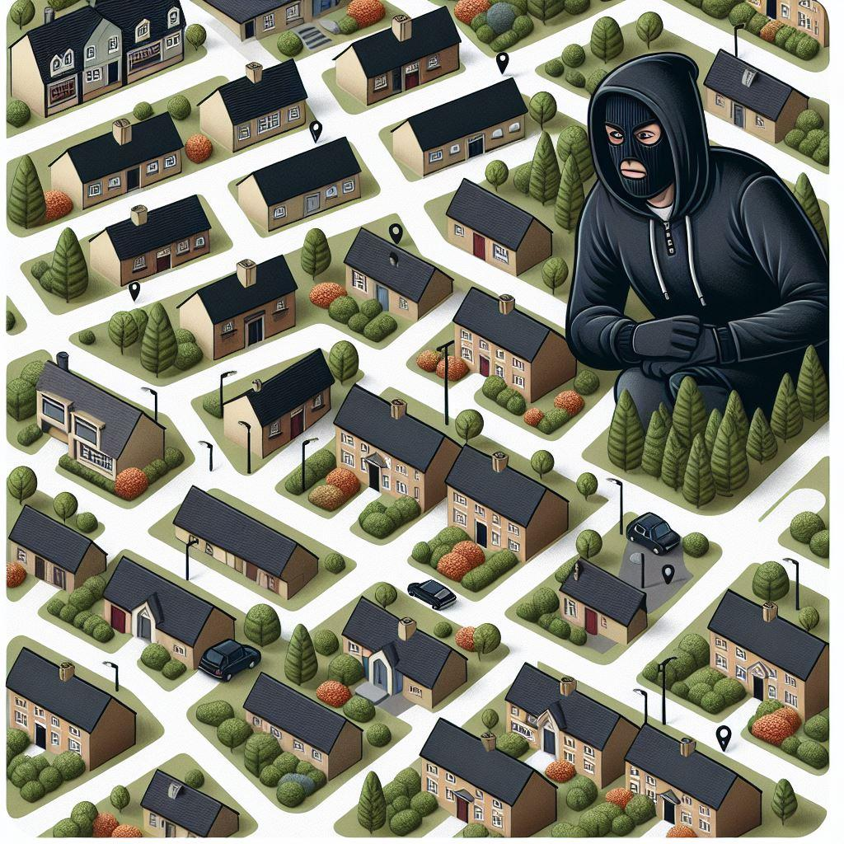
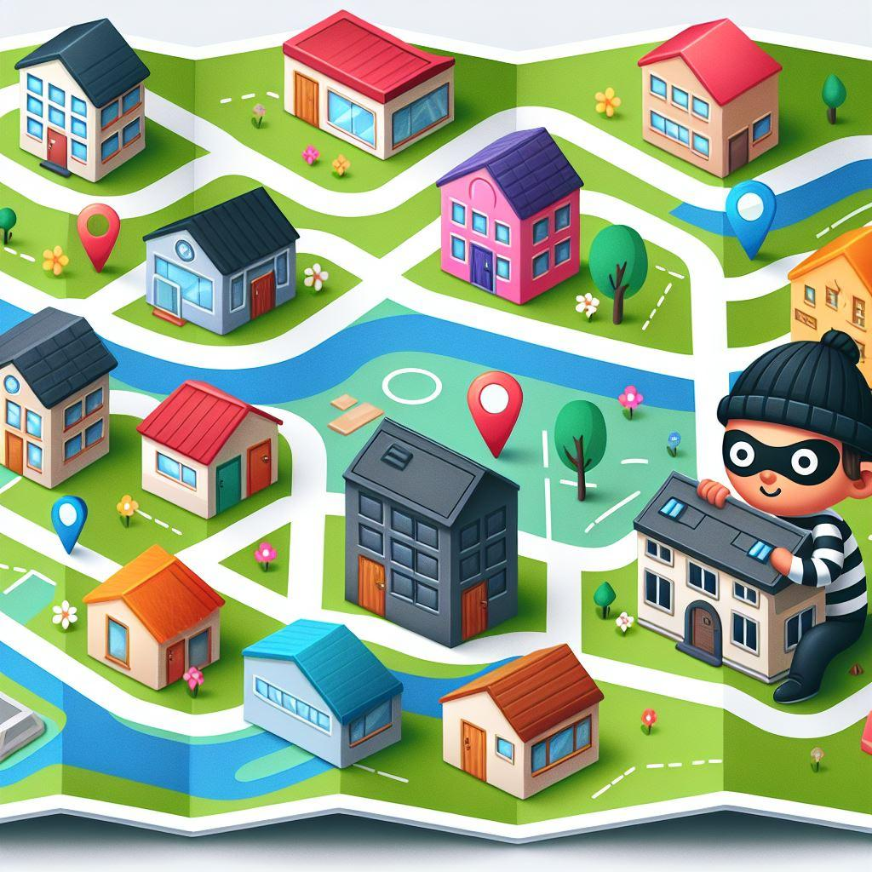
Privacy Budget
Each query (interaction) uses up a portion of the privacy budget. The more you ask, the less precise the answers become as noise is added
Why It Matters: It ensures data remains private by limiting how much can be learned over time. Protects against revealing too much information about any individual
Key Concept:
More queries = More noise = Less accuracy
Notes:
Nikita
"Now that we’ve introduced differential privacy, let’s talk about the concept of a privacy budget.
Imagine playing a game where you’re trying to catch a robber hiding on a map. You can ask questions like, 'Is the robber near this location?' But here’s the catch: with each query, you’re using up your privacy budget. To protect the robber’s location, the answers become noisier as you ask more questions.
For example, your first query might give you a precise hint, like 'The robber is in the north section of the map.' But as you ask more, the responses become less accurate, like 'Maybe somewhere near the east.'
This balance ensures that while you can gather enough information to narrow down possibilities, you can’t pinpoint the exact location, keeping the data secure. The more you query, the noisier the answers get, maintaining privacy for the robber.
This idea of a privacy budget is crucial in differential privacy—it limits how much information can be extracted, protecting individual data while allowing meaningful analysis."

Slide 25
We played a game without a privacy budget, now lets play a game with it

Slide 26
DPiscool.anvil.app

Slide 27
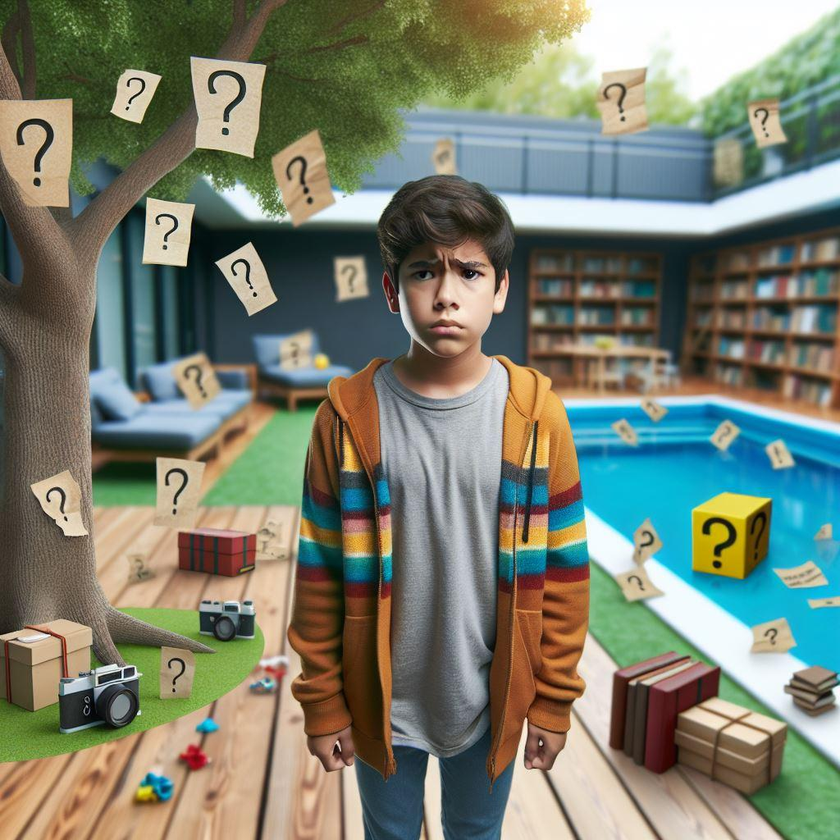
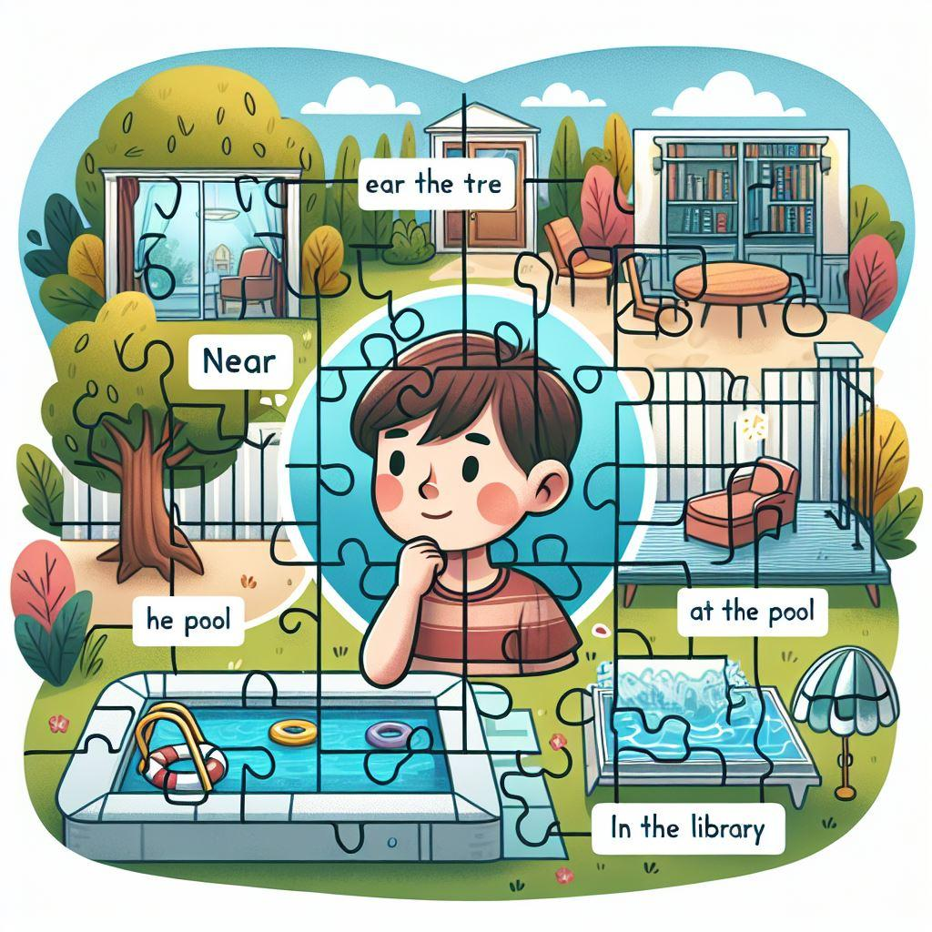
Challenges of Differential Privacy
Too Few Participants:
For example - Visited only couple of locations.
Too Much Noise (Blur):
For example - More clues get too blurry or confusing
So, in the game—and in real life with privacy—it's about finding a balance.
Notes:
Nikita
However, there are challenges:
Too Few Participants: If there were only a couple of objects in this photo, like just one car and one tree, it might be hard to spot meaningful patterns.
Too Much Noise: On the other hand, if the photo is too blurry, like you struggled to identify STOP signal, even if there was one
So, differential privacy requires a balance—it needs to blur enough to protect individual privacy but not so much that the data becomes meaningless. Just like in iSpy, finding the sweet spot is key!"

Slide 28
Protecting your secrets!
04.
Notes:
Brinda

Slide 29


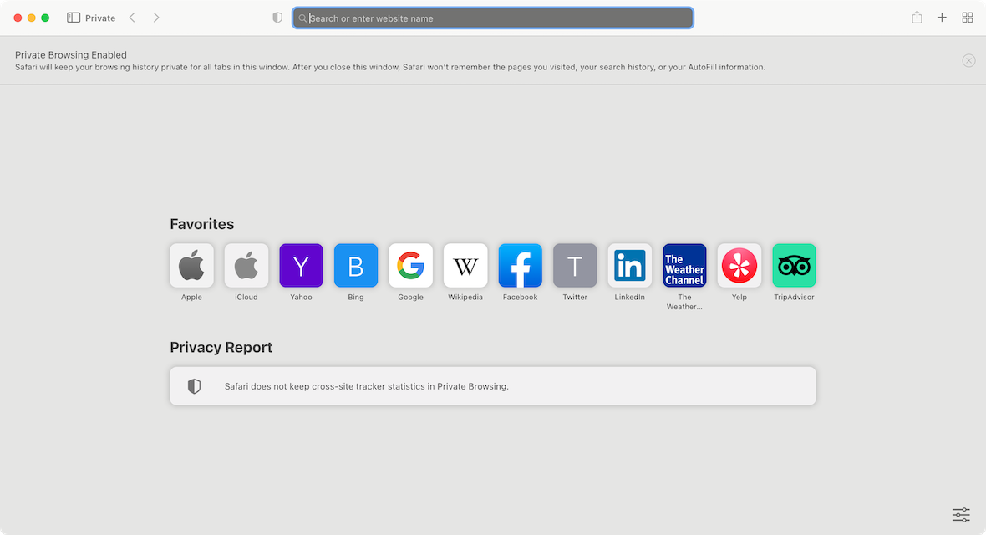
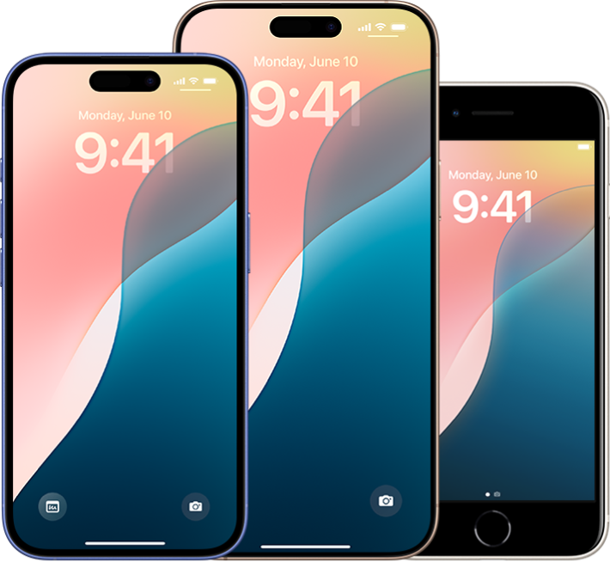
Where Does DP Exist?
EXAMPLE:
Notes:
-A great example of DP in action is Apple. Apple uses Differential Privacy in several of its services, like Safari and the iPhone keyboard, to improve user experience without compromising your privacy.
Let’s start with Safari, Apple’s web browser. When you use Safari, whether in normal mode or private browsing, Apple ensures that your personal data, like the websites you visit or your search history, isn’t tied to you as an individual
-Here’s how it works: Instead of collecting raw data about your browsing habits, Apple uses Differential Privacy to add random ‘noise’ to the information it collects. This means your data is mixed with millions of other users’ data, so it’s impossible to trace any patterns back to you
-This method ensures that Safari remains fast, efficient, and secure while respecting your privacy

Slide 30
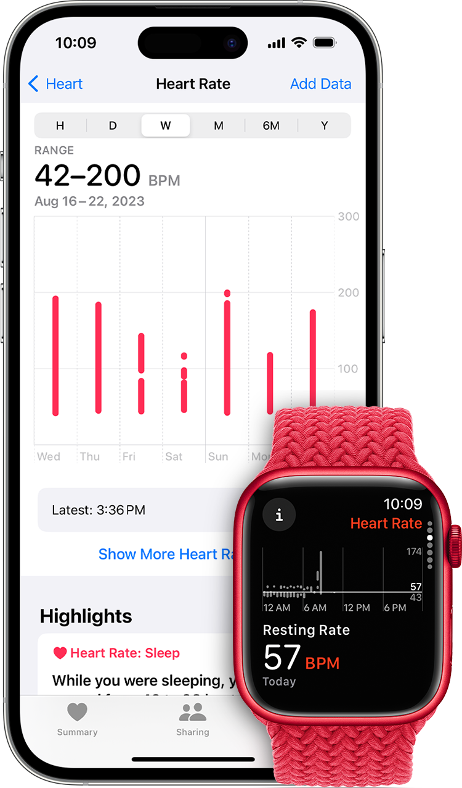
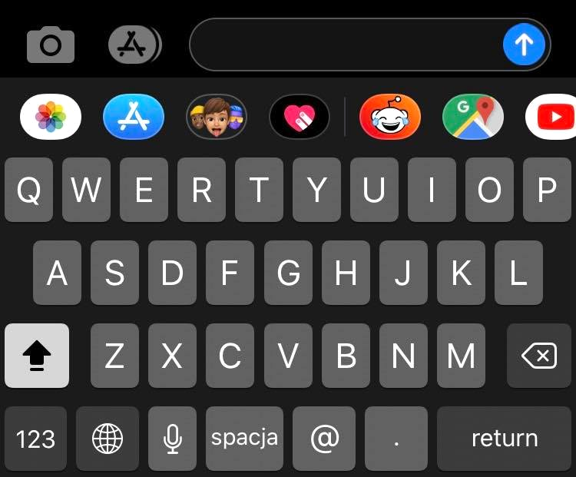
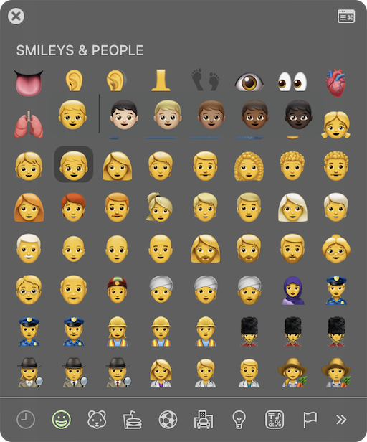
Where Does DP Exist?
EXAMPLE:
Notes:
Brinda
-Now, let’s look at your iPhone’s keyboard. Have you noticed how it gets better at predicting your next word or suggesting emojis you use often? This is also thanks to Differential Privacy.
-When you type, the keyboard learns patterns—like common words, phrases, or emojis—but instead of storing your exact data, it applies Differential Privacy to anonymize it before sending it to Apple’s servers
-For instance, Apple might use this data to find out that most people are using a new emoji, like the melting face emoji. They can then make it easier to access in the emoji picker.
-But the key here is that Apple never knows who is using the emoji or what you’re typing—it only sees anonymized trends across its millions of users
-This allows Apple to improve autocorrect and suggestions for everyone while making sure no one’s personal typing habits are exposed
Health DAta
-Let’s say Apple wants to learn how people use their Health app to improve features. Instead of analyzing your raw health data directly, they apply DP to aggregate information across millions of users while keeping individual records private.
-For example, Apple might use anonymized data to find trends, like how many people are monitoring their heart rate after exercise or tracking specific health goals. This helps them design better tools, like new workout modes or personalized health notifications

Slide 31
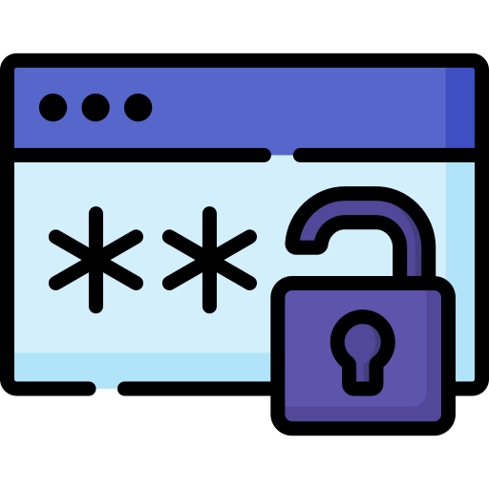

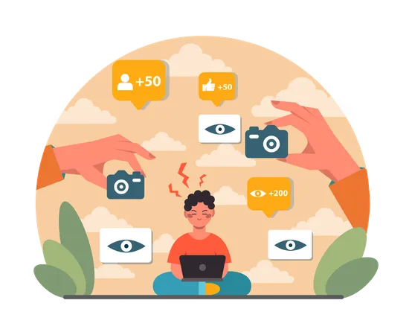
Protecting Your Secrets
Don’t Share
Your Passwords
Sharing on
the Internet
Oversharing
is Risky
Notes:
Brinda

Slide 32


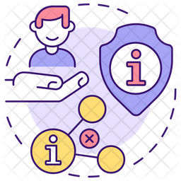
Protecting Your Secrets
If it looks suspicious, it probably is suspicious
Use Privacy
Settings
Respect
Others’ Privacy
Notes:
Brinda

Slide 33
THANK YOU!
Do you have any questions for us?
Notes:
Brinda

